Slide 1
Topic: interpreting Timetables EQ: How do I read, interpret and use a train timetable ?
Year 11 Mathematics Essentials

Slide 2
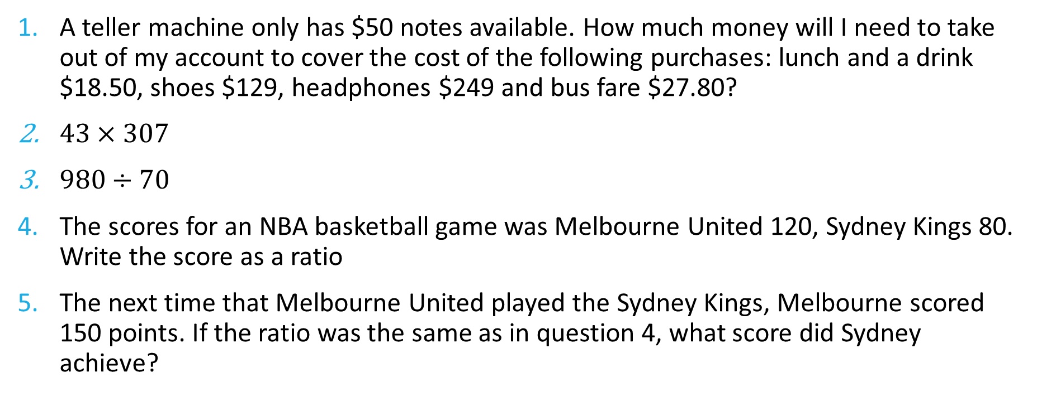
Five Questions
Topic: Interpreting Timetables
Date: XX/XX/2021
EQ – How do I read, interpret and use a train timetable
A teller machine only has $50 notes available. How much money will I need to take out of my account to cover the cost of the following purchases: lunch and a drink $18.50, shoes $129, headphones $249 and bus fare $27.80?
$43×307$
$980÷70$
The scores for an NBA basketball game was Melbourne United 120, Sydney Kings 80. Write the score as a ratio
The next time that Melbourne United played the Sydney Kings, Melbourne scored 150 points. If the ratio was the same as in question 4, what score did Sydney achieve?
Notes:
$450
13201
140
120:80 or 3:2
100

Slide 3
24
7
30
Date: XX/XX/2021
Topic: Timetables
EQ – How do I read, interpret and use a train timetable?
Timetables help us organise schedules. There are many different types of timetables in our everyday lives such as bus, TV, movie and even class timetables.
We need to calculate elapsed time in order to work out timetables.
WICOR

Slide 4
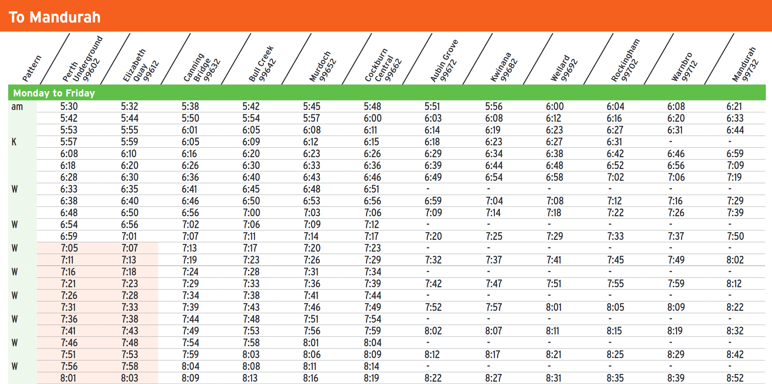
How long is the journey from Perth Underground to Mandurah if I leave at 5:30 am?

Slide 5
How long is the journey from Perth Underground to Mandurah if I leave at 5:30 am?

Slide 6
24
7
30
Date: XX/XX/2021
Topic: Timetables
EQ – How do I read, interpret and use a timetable?
The Mandurah train line leaves Perth Underground at 5:30 am and arrives in Mandurah at 6:21 am. How long is the trip?
We need to work out the elapsed time. This means we keep adding chunks of time to 5:30 until we arrive at 6:21 am
5:30 am | 6:21 am
6:00 am 6:20 am 6:21 am | + 30 mins + 20 mins + 1 min
WICOR
51 minutes

Slide 7
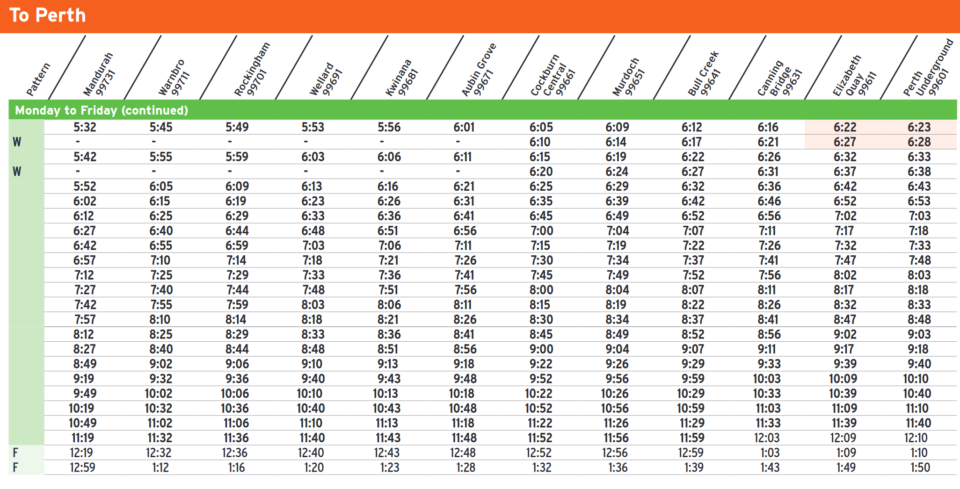
When leaving Mandurah, I want to get the train that will get me to Bull Creek by Midnight as I’m being picked up then.
What is the latest train I can get?
How long will the trip take?

Slide 8
When leaving Mandurah, I want to get the train that will get me to Bull Creek by Midnight as I’m being picked up then.
What is the latest train I can get?
How long will the trip take?

Slide 9
24
7
30
Date: XX/XX/2021
Topic: Timetables
EQ – How do I read, interpret and use a timetable?
The Mandurah train line leaves Mandurah at 11:19 pm and arrives in Bulls Creek at 11:59 pm. How long is the trip?
We need to work out the elapsed time. This means we keep adding chunks of time to 11:19 pm until we arrive at 11:59 pm
11:19 pm | 11:59 pm
11:49 pm 11:59 am | + 30 mins + 10 mins
40 mins
WICOR

Slide 10
Extension Question.
Three trains travel from City Station to Farmland Station on the same morning. The Express leaves City 10 minutes after the All Stations train, but arrives at Farmland 10 minutes before it.
The All Stations takes 50 minutes to reach Farmland and arrives at 10:30.
The Goods train leaves 20 minutes before the All Stations and arrives at Farmland 20 minutes after the Express.
Work out the timetable. That is; what time does each train leave City Station and what time does each train arrive at Farmland Station?

